Slide 1
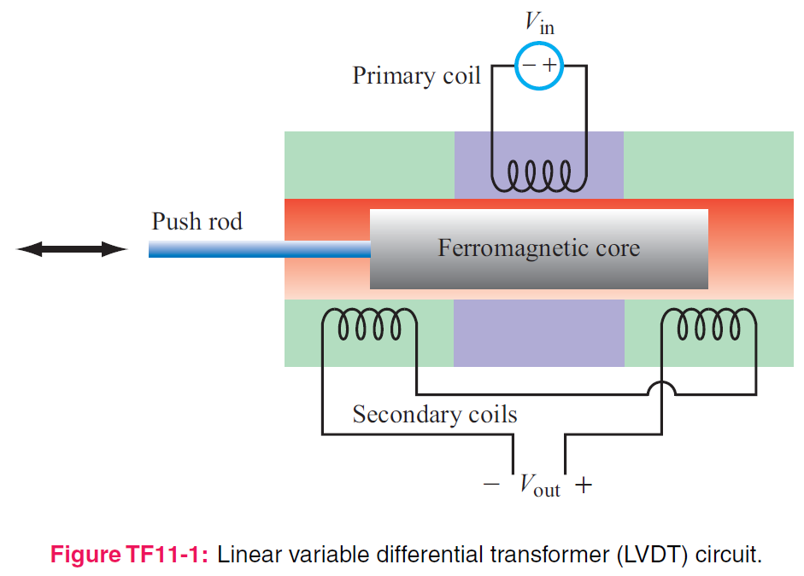
5. Magnetostatics
7e Applied EM by Ulaby and Ravaioli

Slide 2
Chapter 5 Overview

Slide 3
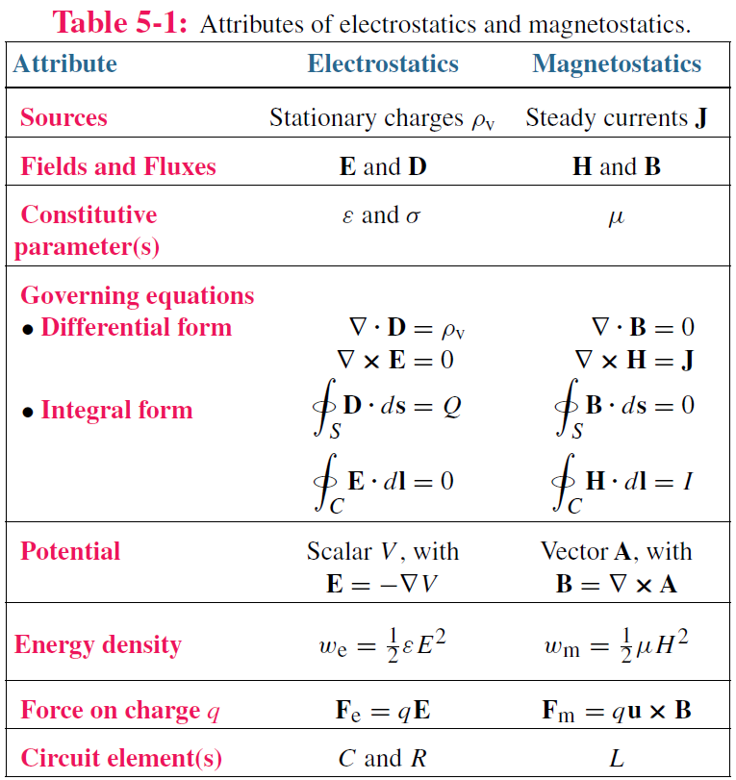
Electric vs Magnetic Comparison

Slide 4
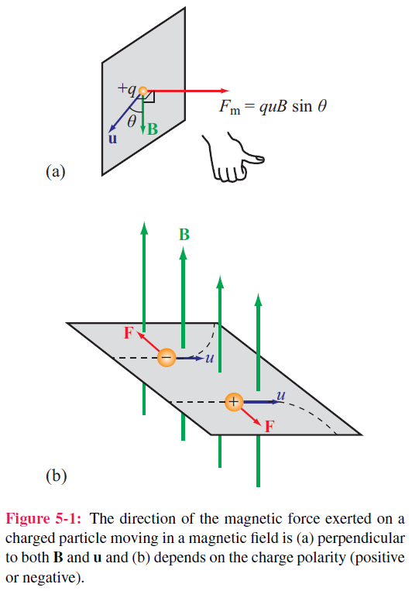

Electric & Magnetic Forces
Magnetic force
Electromagnetic (Lorentz) force
Three differences between F_{e} and F_{m}

Slide 5
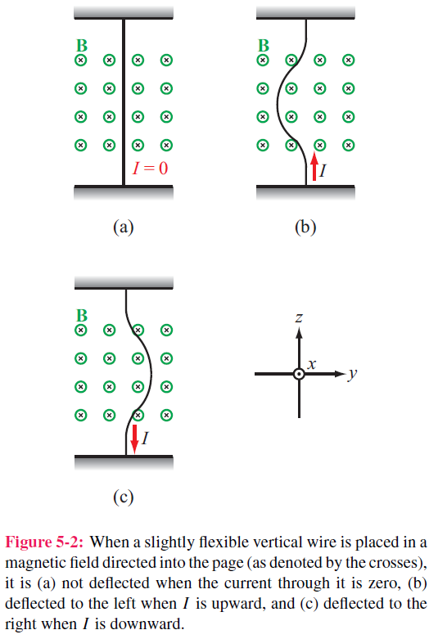
Magnetic Force on a Current Element
Magnetic force

Slide 6
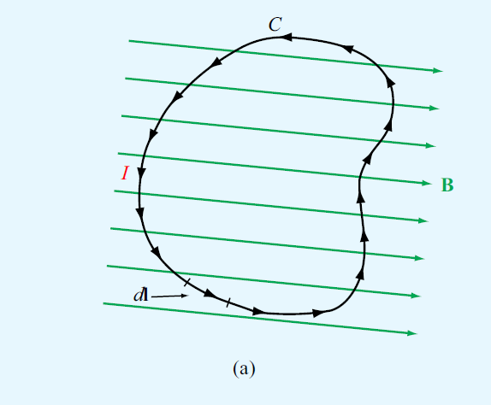
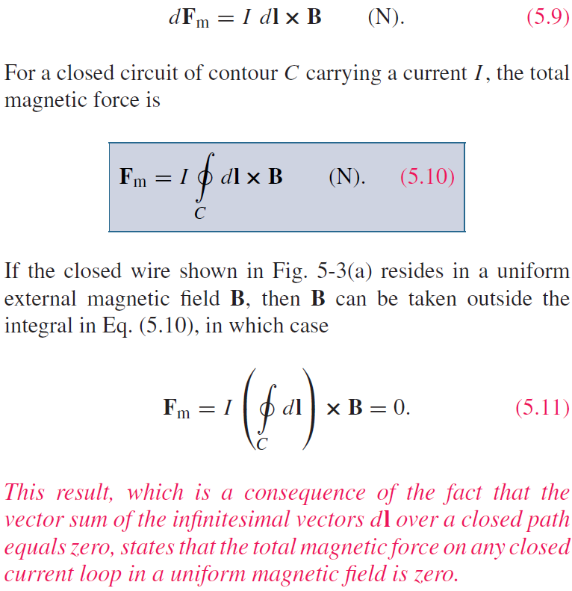
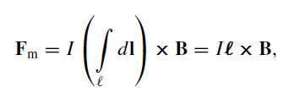
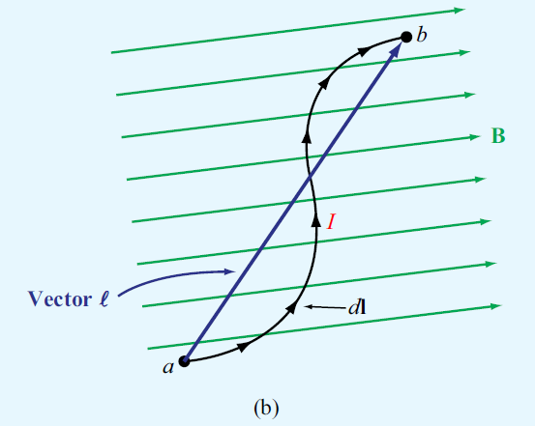
Magnetic Force on a Current Element
Differential force dFm on a differential current I dl:
The M force integration is independent on the path, for a part
Note that for open wire circuit, it is not static M.

Slide 7
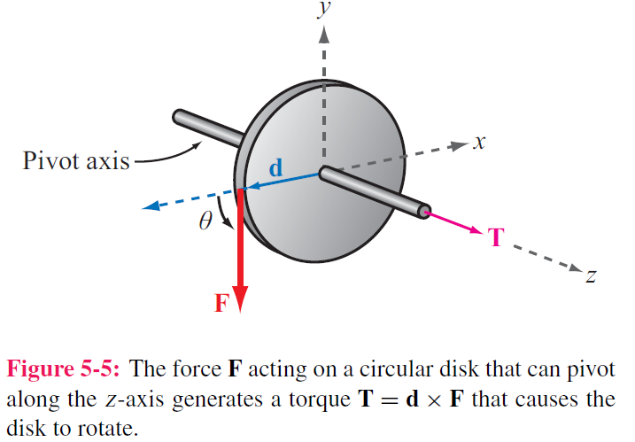

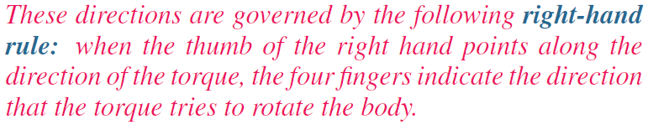
Torque
d = moment arm
F = force
T = torque

Slide 8
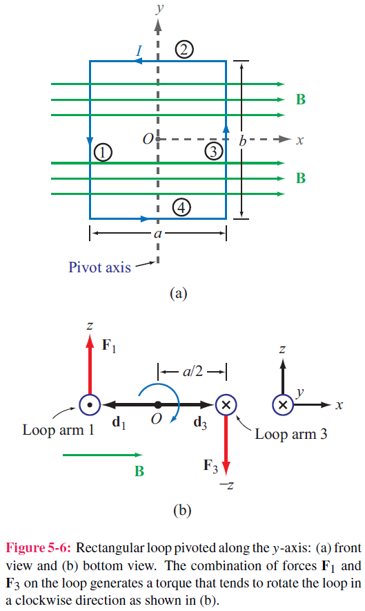
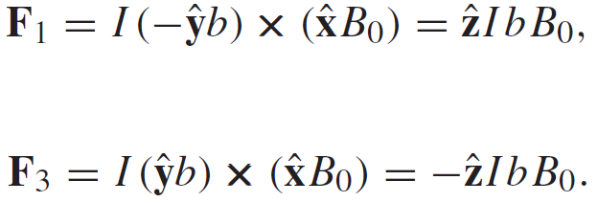
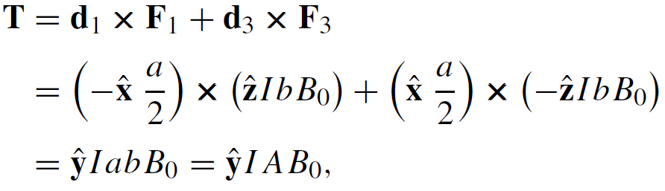
Magnetic Torque on Current Loop
In case the current loop is in plane with B
No forces on arms 2 and 4 ( because I and B are parallel, or anti-parallel)
Magnetic torque:
Area of Loop

Slide 9
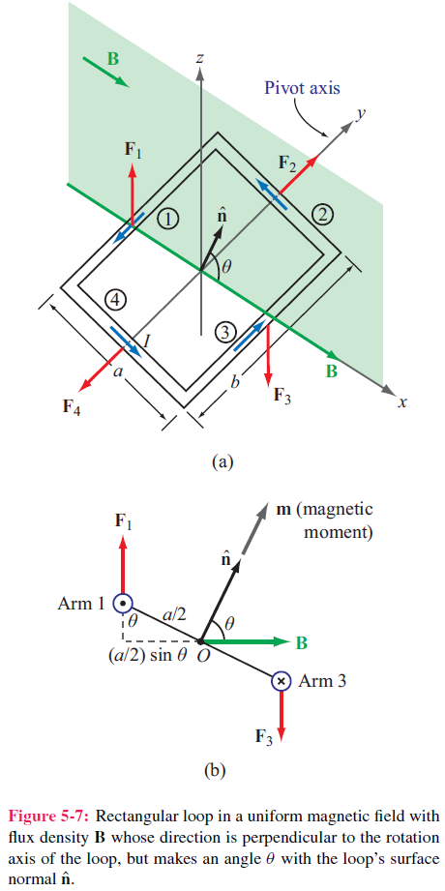
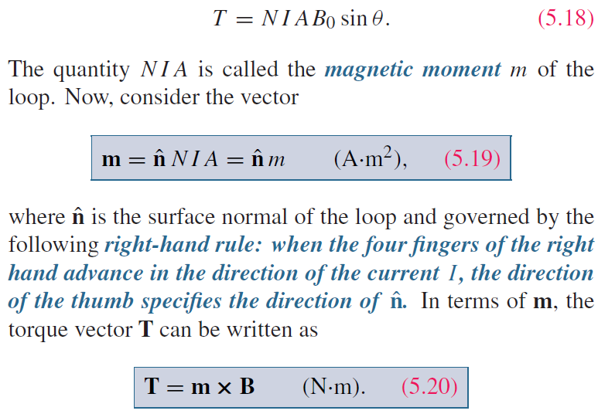
Inclined Loop
For a loop with N turns and whose surface normal is at angle theta relative to B direction:

Slide 10
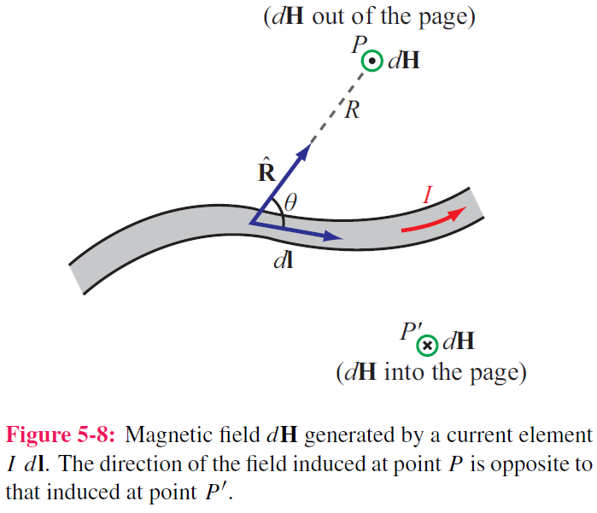

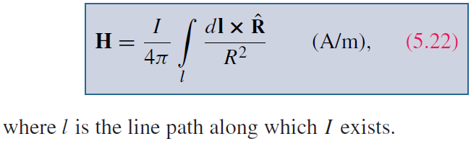
Biot-Savart Law
Magnetic field induced by
a differential current:
For the entire length:

Slide 11
Magnetic Field due to Current Densities

Slide 12
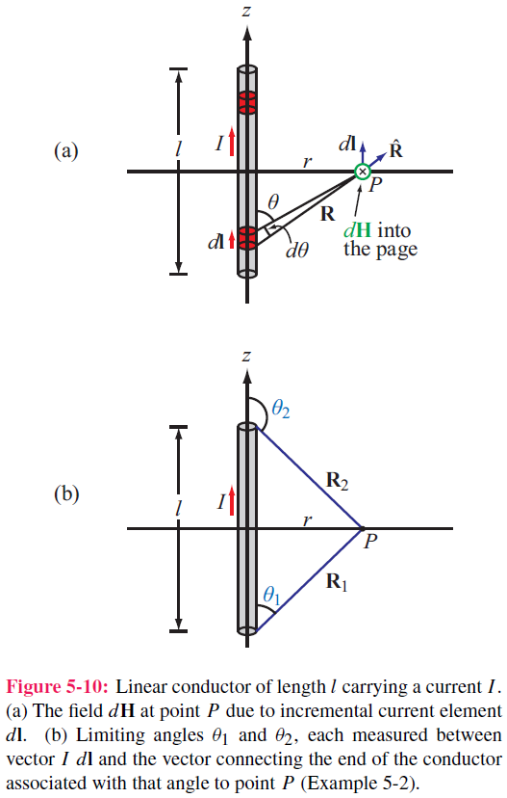
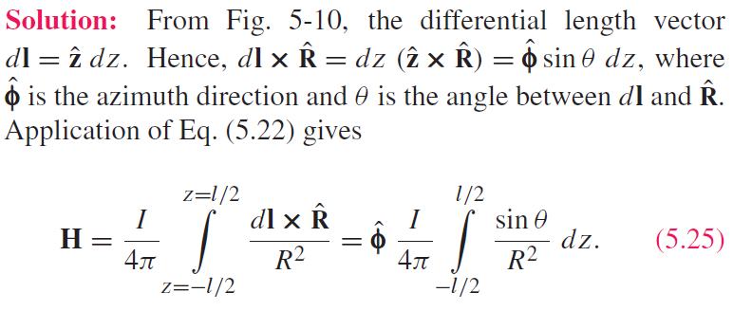
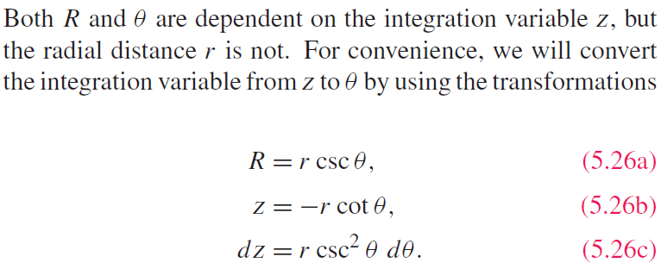
Example 5-2: Magnetic Field of Linear Conductor
Cont.

Slide 13
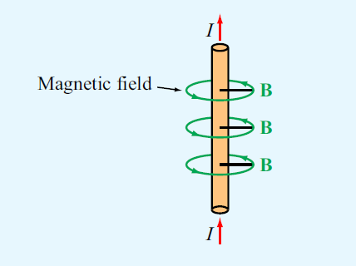
Example 5-2: Magnetic Field of Linear Conductor (cont.)

Slide 14
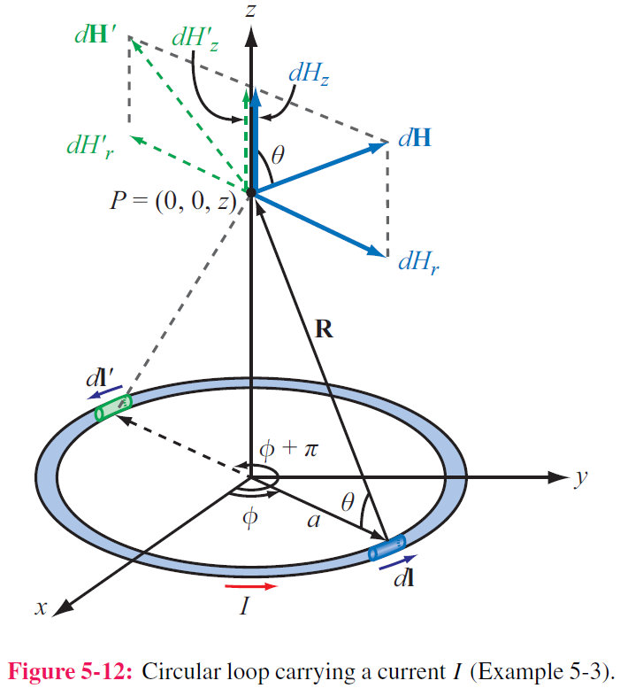
Example 5-3: Magnetic Field of a Loop
Magnitude of field due to dl is
dH is in the r–z plane , and therefore it has
components dHr and dHz
z-components of the magnetic fields due to dl and dl’ add because they are in the same direction,
but their r-components cancel
Hence for element dl:
Cont.

Slide 15
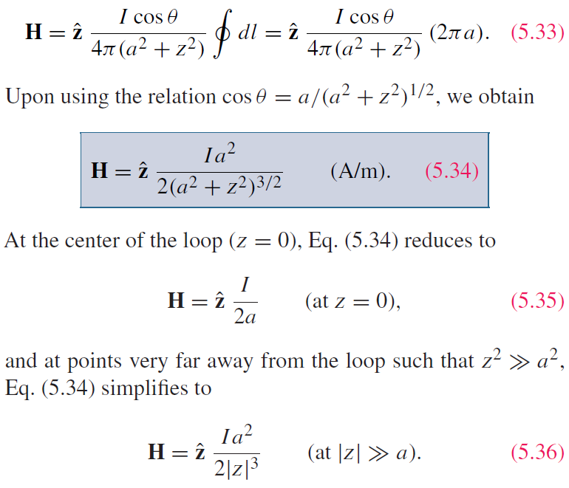

Example 5-3:Magnetic Field of a Loop (cont.)
For the entire loop:

Slide 16
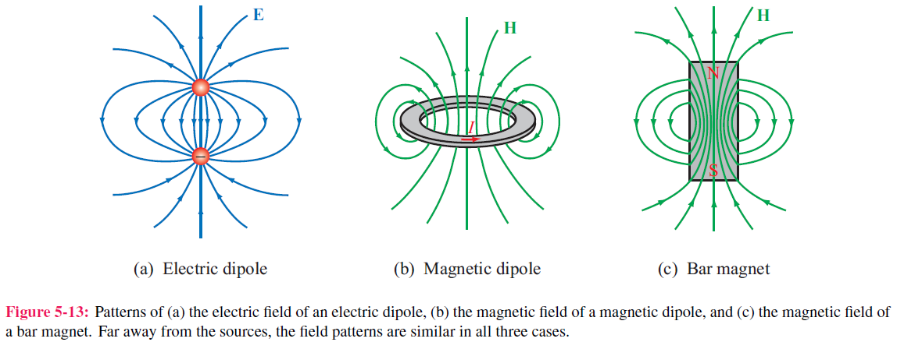
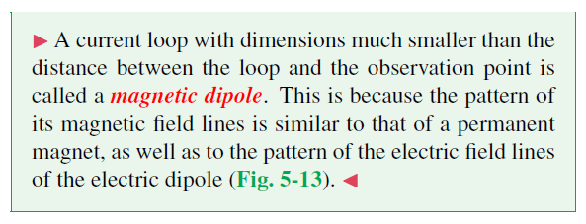
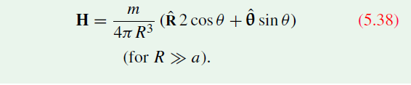
Magnetic Dipole
The M field at the observation point:

Slide 17
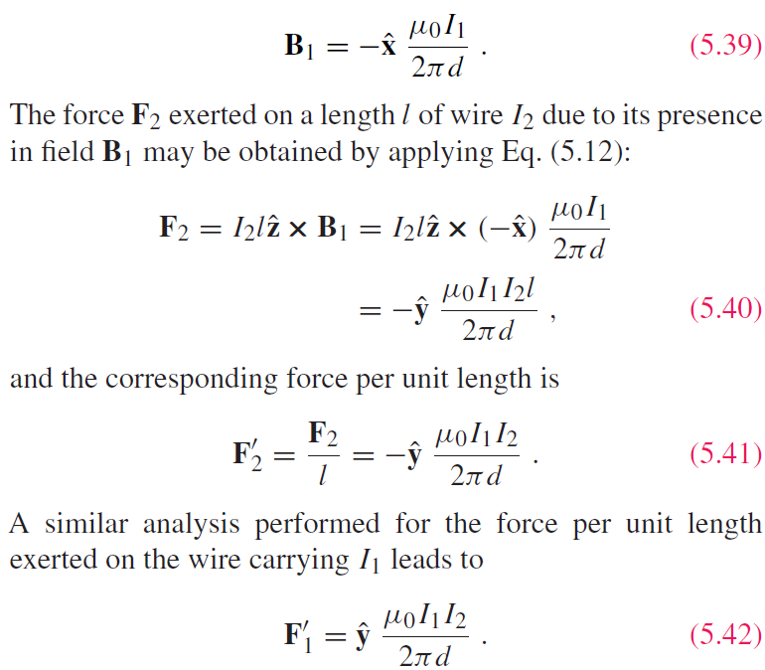
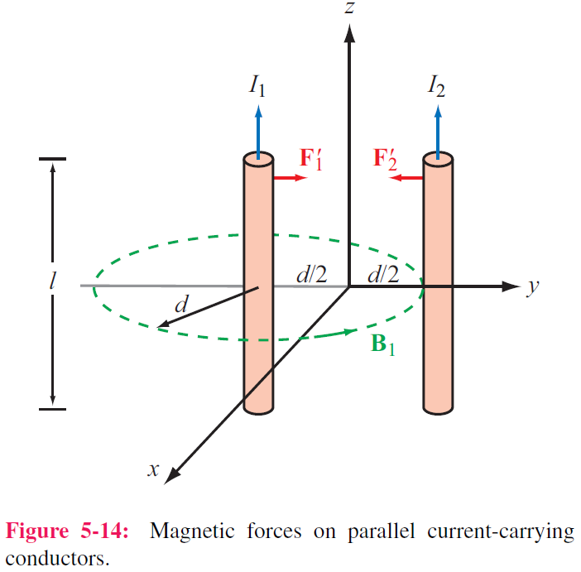
Forces on Parallel Conductors
Parallel wires attract if their currents are in the same direction, and repel if currents are in opposite directions

Slide 18
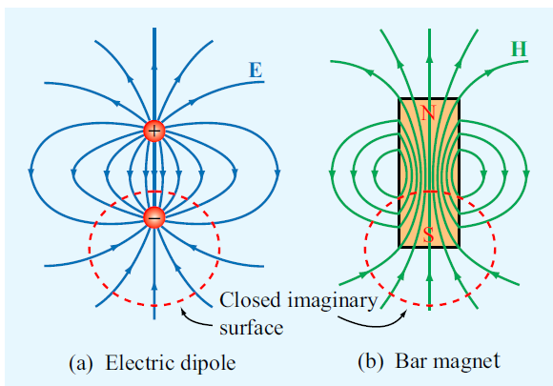
Gauss’s Law for Magnetism
Gauss’s Law for Electricity
Gauss’s Law for Magnetism
No magnetic monopole
Magnetostatics
Electrostatics
Always Closed

Slide 19
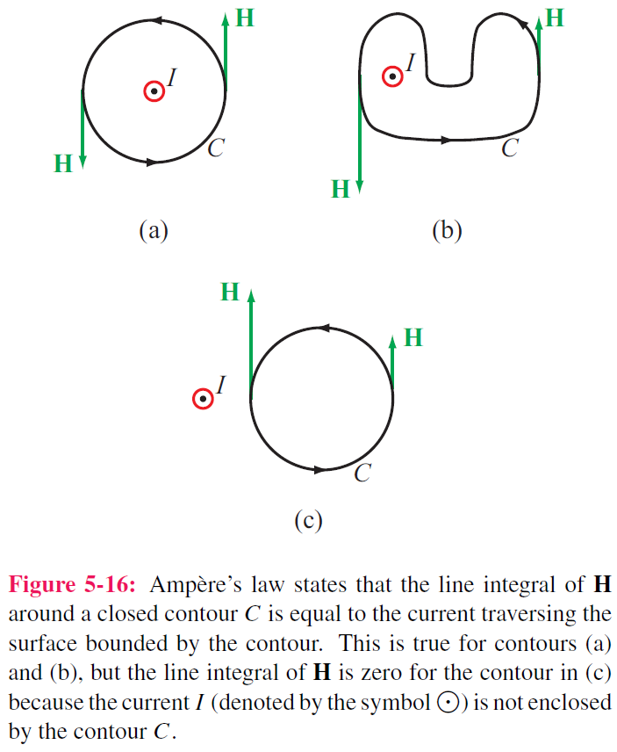
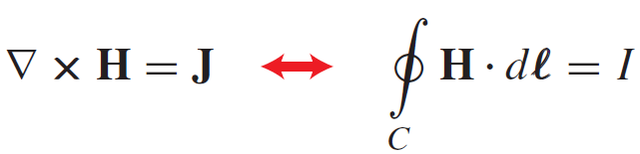
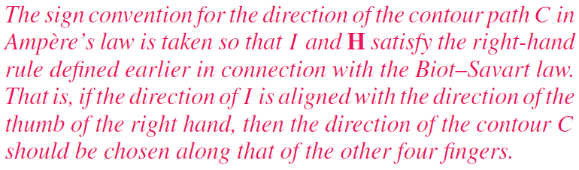
Ampère’s Law
Conservative
Not Conservative unless I = 0

Slide 20
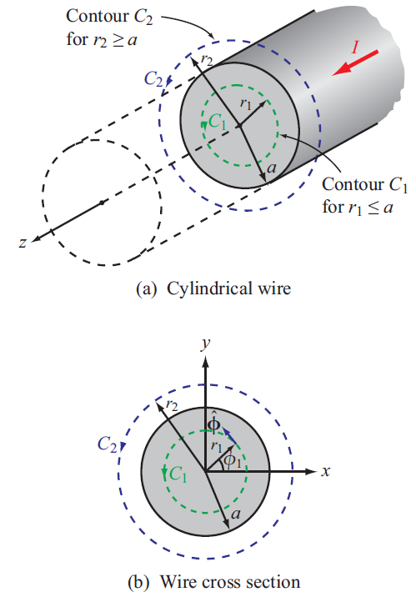
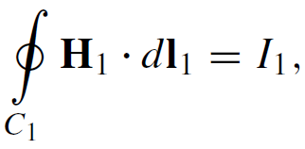
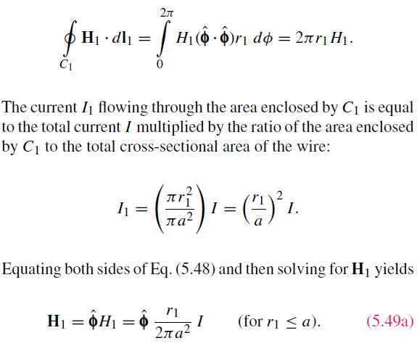
Internal Magnetic Field of Long Conductor
For r < a
Cont.

Slide 21
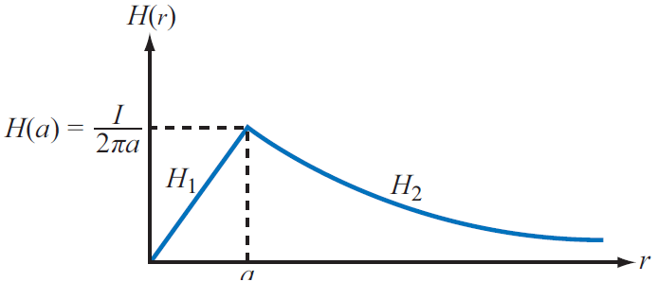
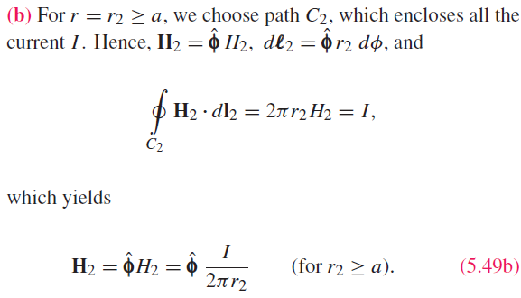
External Magnetic Field of Long Conductor
For r > a

Slide 22
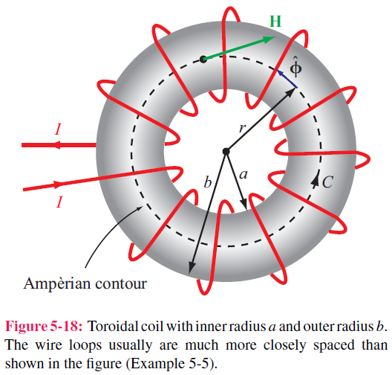
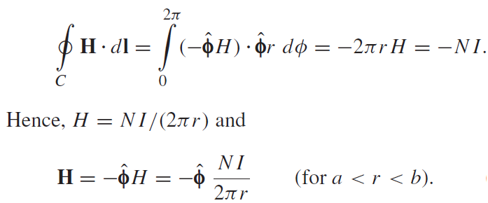
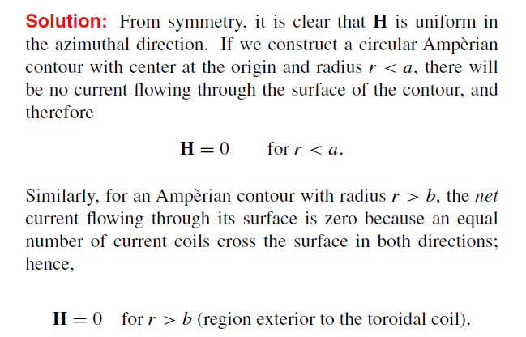
Magnetic Field of Toroid
Applying Ampere’s law over contour C:
Ampere’s law states that the line integral of H around a closed contour C is equal to the current traversing the surface bounded by the contour.
The magnetic field outside the toroid is zero.

Slide 23




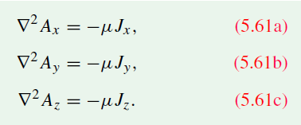


Vector magnetic potential
Analog to the electric potential, the magnetic potential is defined as
From Ampere’s law,
We get Vector Poisson’s equation,
The integral form is

Slide 24




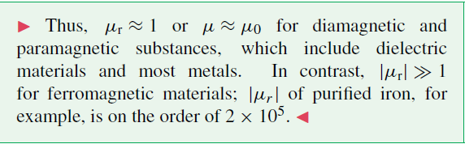

Magnetic permeability
In a material, the M flux
The magnetization vector M is (linear material)
X_{m} is magnetic susceptibility. Hence,
The magnetic permeability is
The relative M permeability is

Slide 25
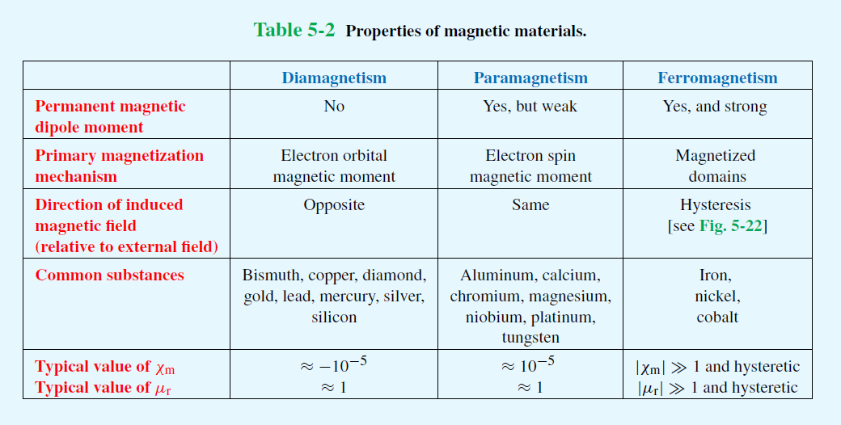
Magnetic materials

Slide 26
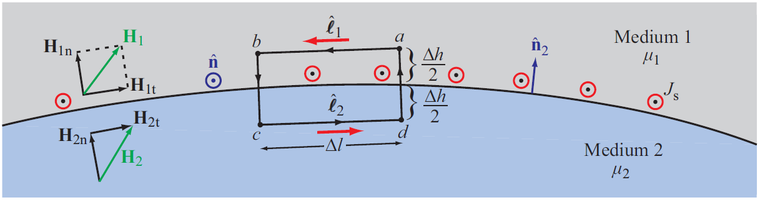
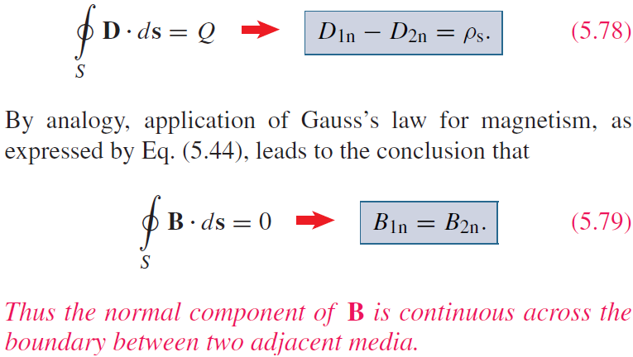
Boundary Conditions

Slide 27

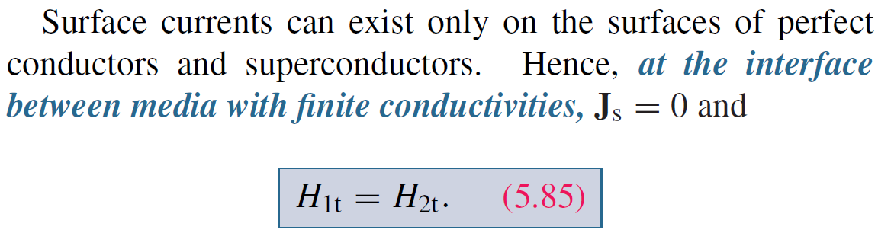




Boundary Conditions
$$∆h→0$$

Slide 28
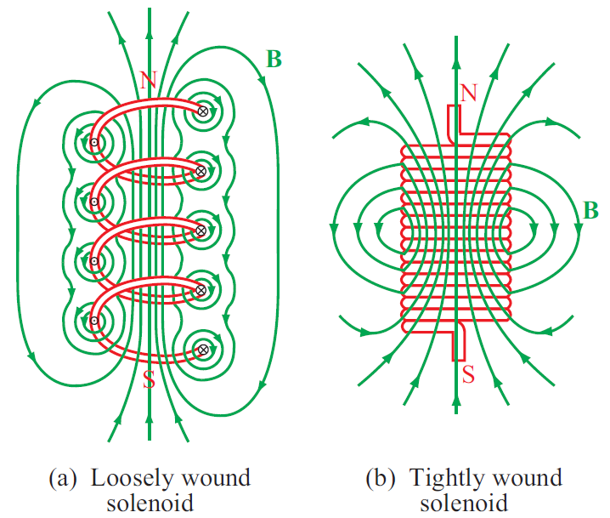

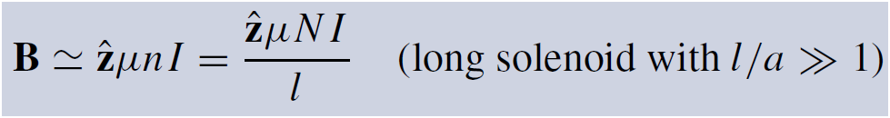
Solenoid
For one circular loop,
Inside the solenoid:

Slide 29
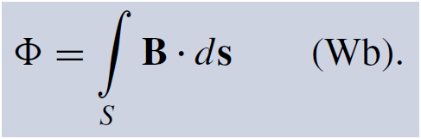

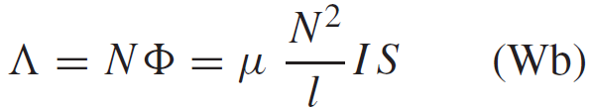


(self) Inductance
Solenoid is a kind of inductor, which stores energy in the M field near its current carrying conductors
For a solenoid, the magnetic flux for a single loop is
M flux Linkage is the total M flux for the whole structure with N loop,
Inductance is the M flux linkage per unit current.
Solenoid (self) inductance

Slide 30


(Self) Inductance
The flux linkage associated with a length l of either line refers to the flux through a closed surface between the two conductors, such as the shaded areas

Slide 31

Example 5-7: Inductance of Coaxial Cable
The magnetic field in the region S between the two conductors is approximately
Total magnetic flux through S:
Inductance per unit length:

Slide 32

Magnetic Energy
Magnetic field in the insulating material is
The magnetic energy stored in the
coaxial cable is

Slide 33

Summary

